Slide 1

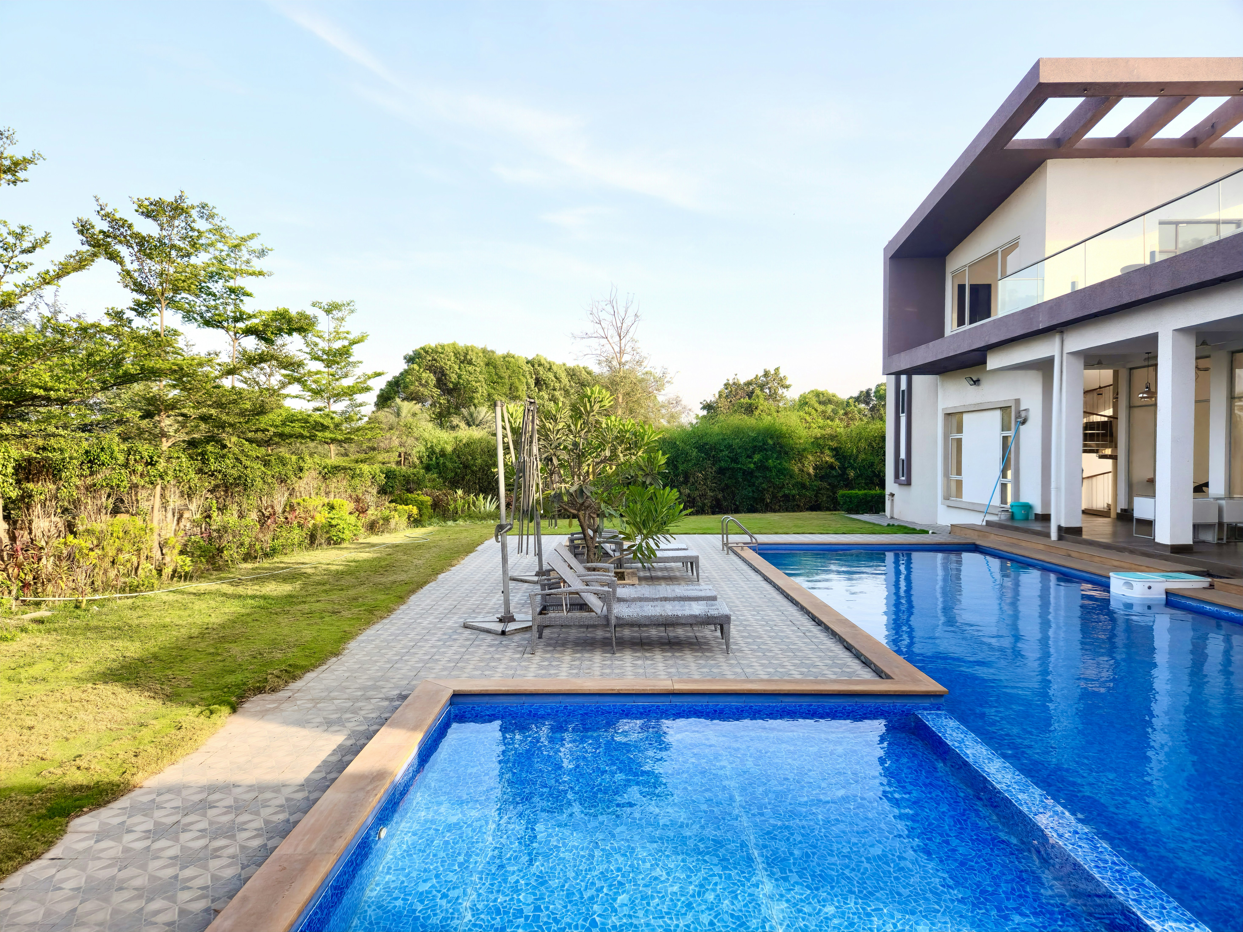
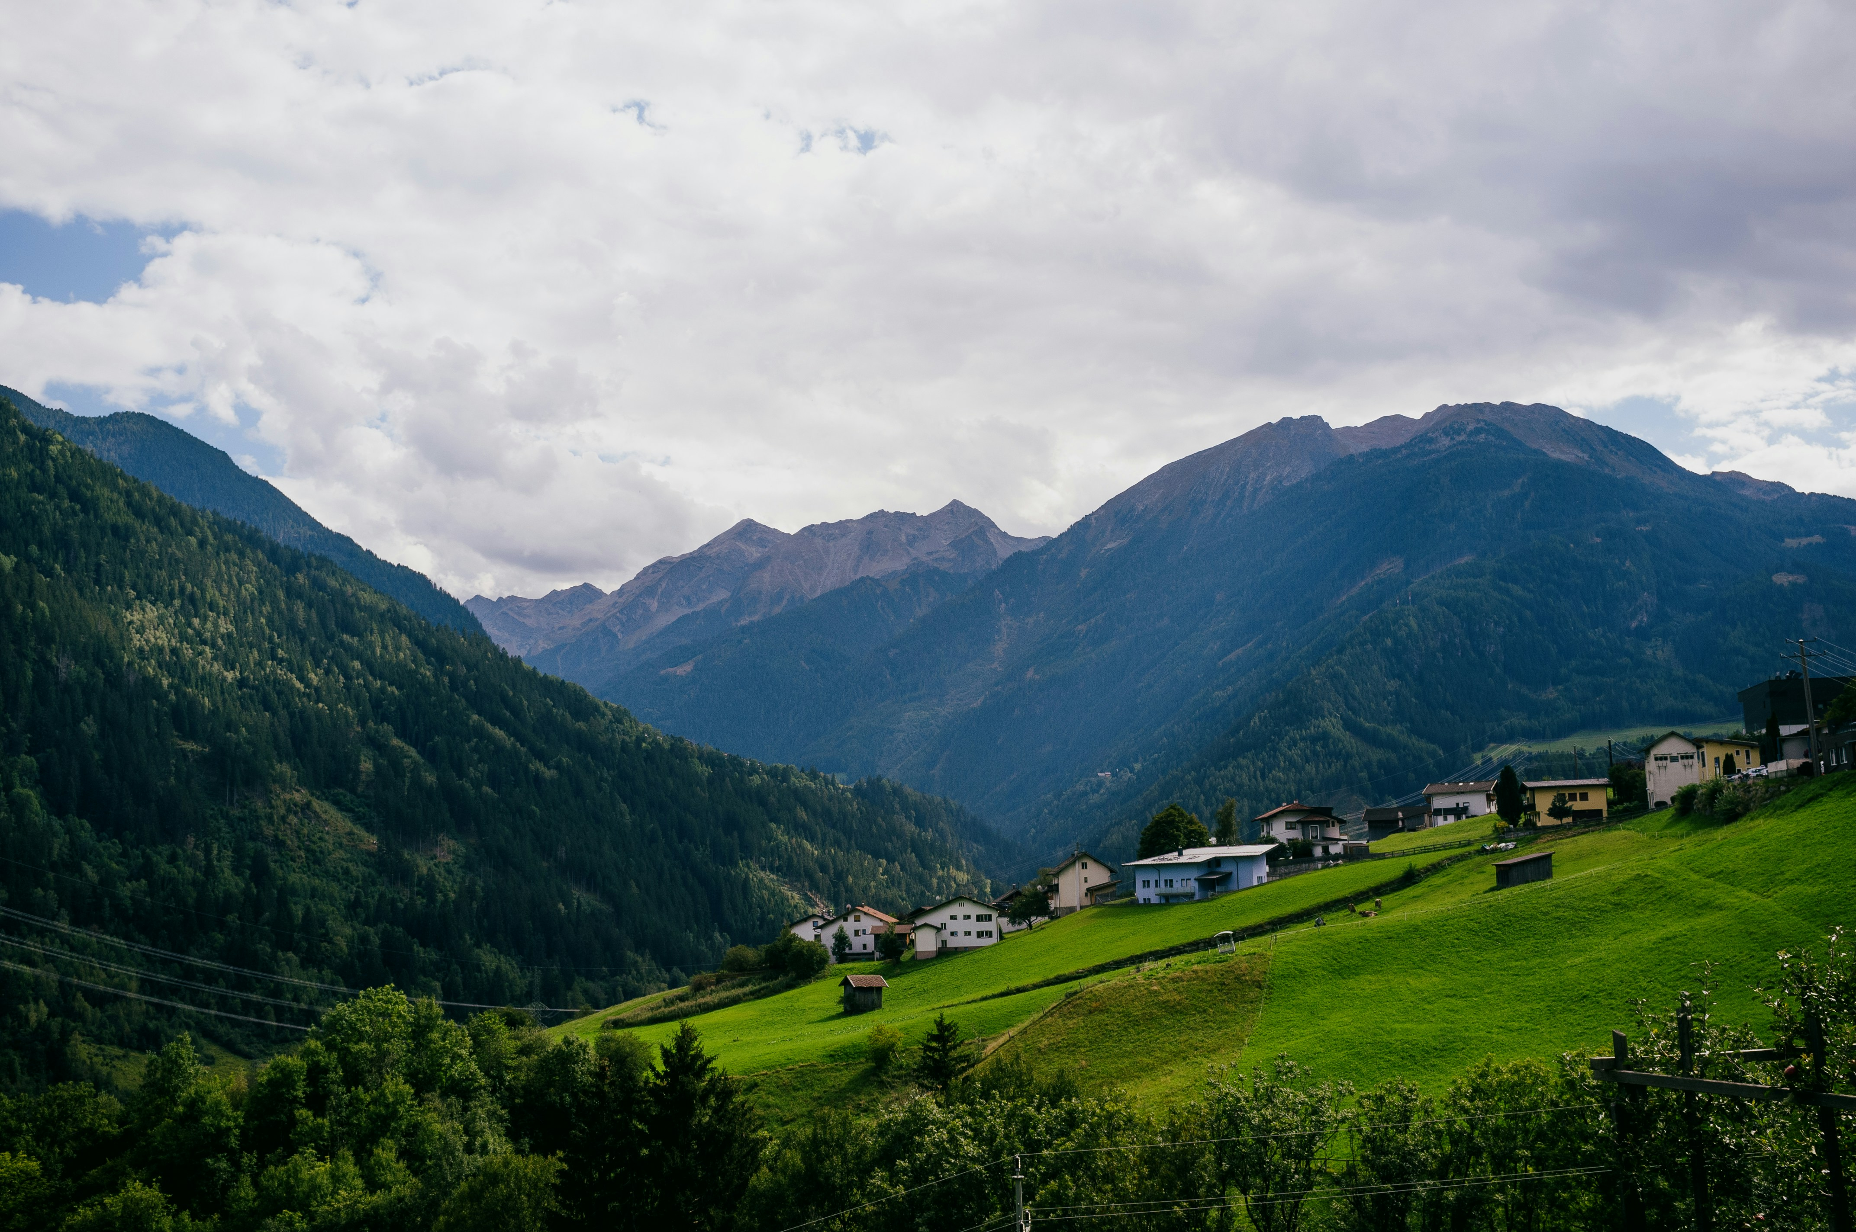
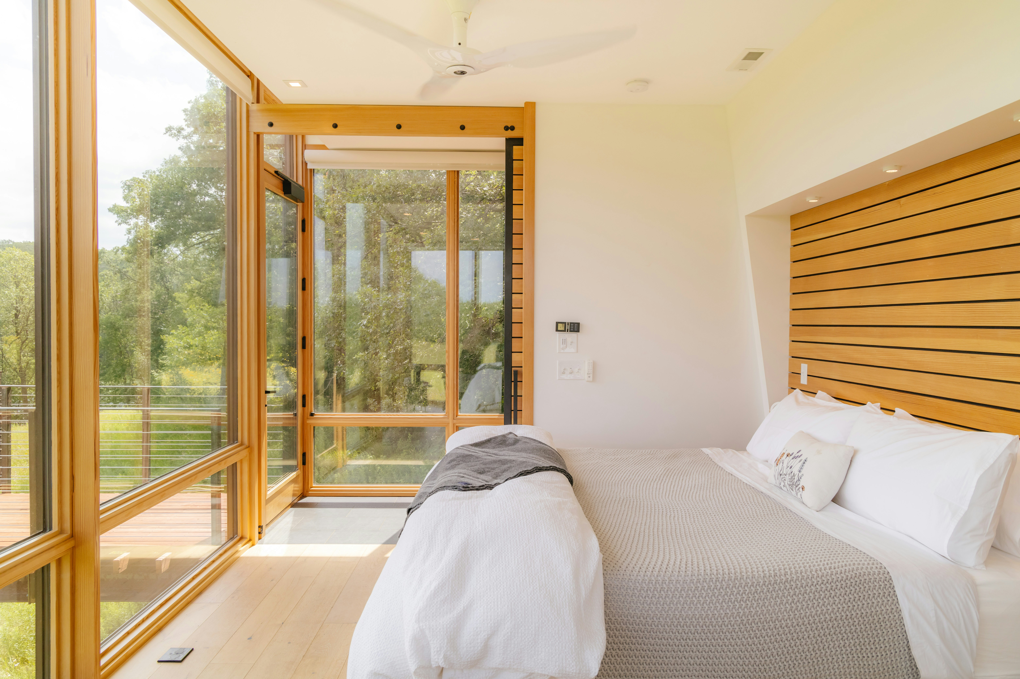

Airbnb Market & Real Estate Analysis
A Data-Driven Analysis of Key Markets

Slide 2

Today's agenda
Background & Context
Methodology/Data Overview
Key Visuals/Performance snapshot
Occupancy/Pricing Trends
Insights
Actionable Recommendations
About the Presenter

Slide 3
Background and context
Airbnb's Dominance: Airbnb has revolutionized the travel and hospitality industry, offering unique lodging experiences.
Market Focus: This analysis focuses on key markets including Big Bear City, Big Bear Lake, Joshua Tree, and Yucca Valley. These areas exhibit significant vacation rental activity.
Purpose: To present a comprehensive overview of Airbnb performance in these regions, identify trends, and provide actionable recommendations for stakeholders.

Slide 4

Data Source: The analysis is based on aggregated Airbnb listing data from 2019 to 2022.
Key Metrics Analyzed:
Revenue: Total Revenue, RevPAL (Revenue Per Available Listing)
Occupancy: Average Occupancy Rate, Occupancy by Season/Month/City
Pricing: Nightly Rates, Yearly Price Distribution
Amenities: Impact of amenities like hot tubs and pools
Host Types: Performance of 2-5 Units, Professionals, and Single Owners.
Tools: Data visualization dashboards.
Methodology/
Data Overview

Slide 5
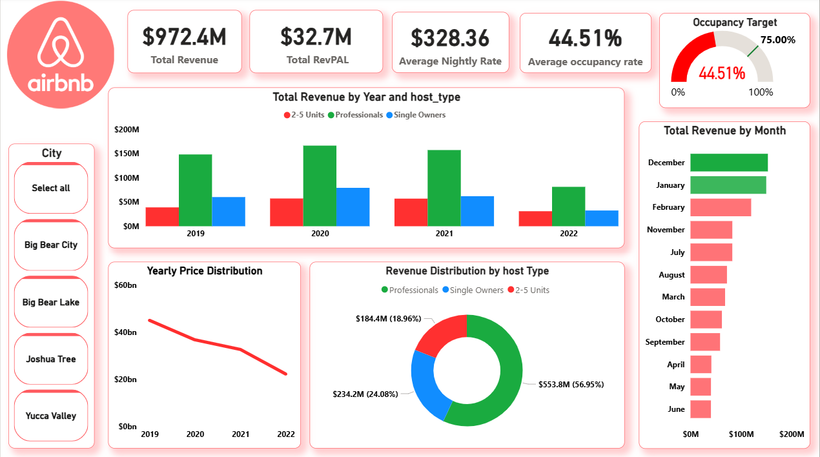
Key Visuals/Performance Snapshot

Slide 6
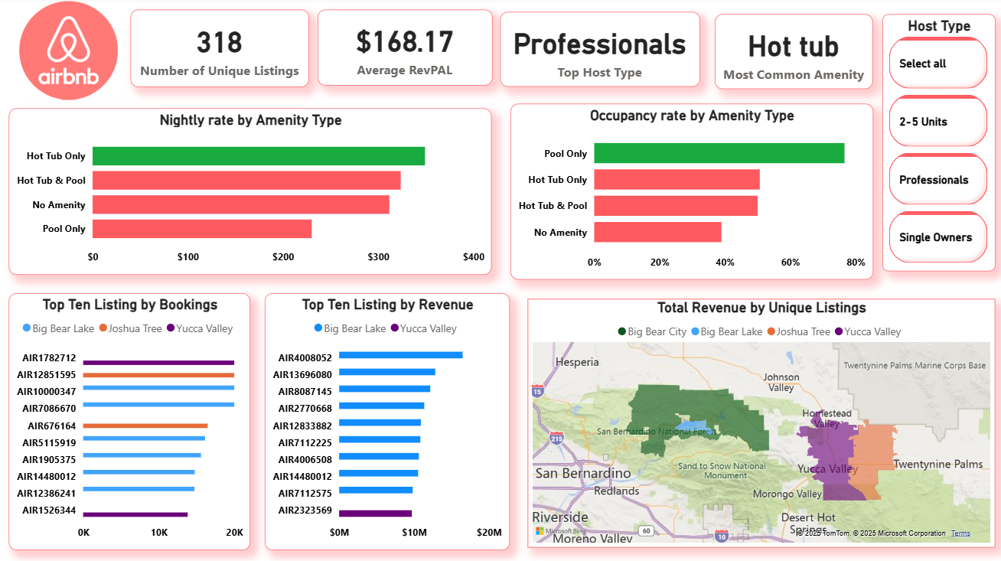

Slide 7
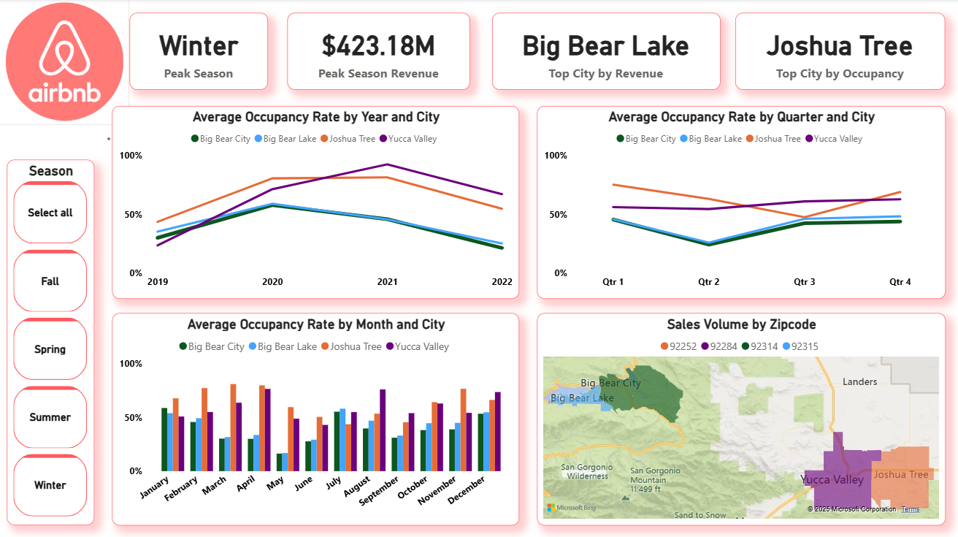
Occupancy/Pricing Trends

Slide 8
Insights
Amenity Advantage: The presence of hot tubs, especially when combined with pools, is a significant driver of both higher nightly rates and occupancy. This suggests a strong guest preference for these amenities.
Seasonal Dynamics: Winter is a high-performing period, particularly in the Big Bear regions. However, there are opportunities to improve occupancy during off-peak seasons.
Host Performance: Professionals contribute the most to total revenue, highlighting the dominant role of large scale hosts in driving the short-term rental market. Single Owners and those with 2-5 units also contribute significantly.
Market Disparities: While Big Bear City commands higher pricing, Joshua Tree excels in occupancy, indicating a high demand relative to its listing inventory. Yucca Valley shows potential but generally lags in both pricing and occupancy.
Occupancy Gap: The overall average occupancy rate of 44.51% is significantly below the 75% target, indicating substantial room for improvement.

Slide 9

Prioritize Amenity Enhancement:
Action: Encourage hot tub/pool additions in Big Bear City and Yucca Valley.
Expected Outcome: Higher nightly rates and increased occupancy.
1
Actionable Recommendations
Optimize Off-Peak Season Strategies:
Action: Implement targeted marketing and pricing for
spring and fall.
Expected Outcome: Improved overall RevPAL and stabilized income.
2
Leverage Joshua Tree's Success:
Action: Analyze Joshua Tree's best practices for high occupancy.
Expected Outcome: Transferable insights to boost performance in other regions.
3

Slide 10

About the Presenter
Name: Mary Uchechi Mbadiwe
Role: Junior Data Analyst & Educator
Background: A Mathematics graduate with a strong passion for turning data into actionable insights. Currently advancing in data analysis and visualization, with experience in education and digital content creation.
Expertise: Microsoft Excel, SQL, Power BI, Data Visualization, and Educational Content Strategy. Contact: maryamarauc5@gmail.com https://www.linkedin.com/in/mary-mbadiwe/

